Slide 1
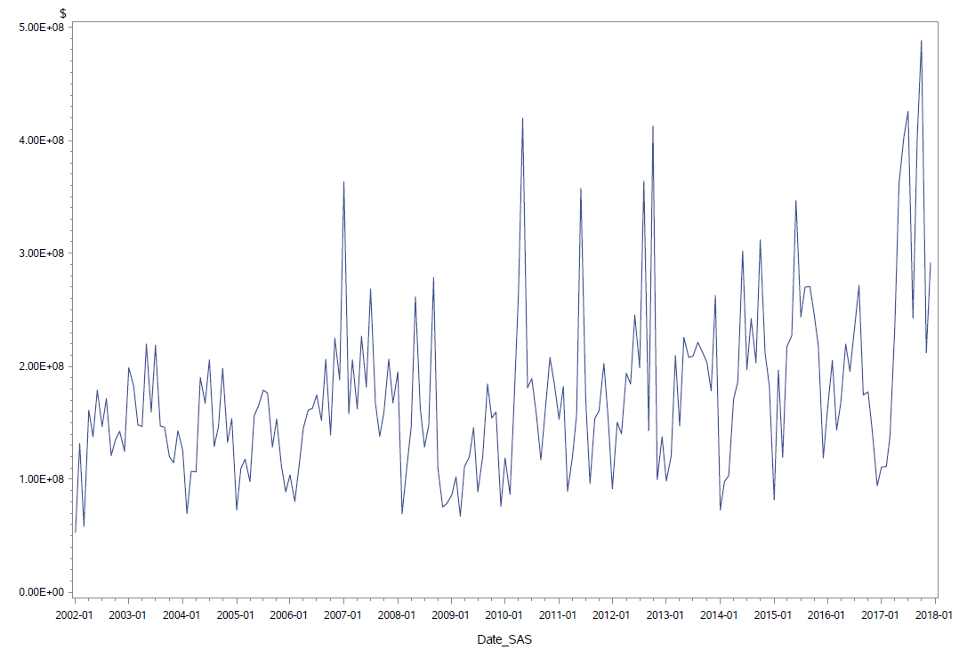
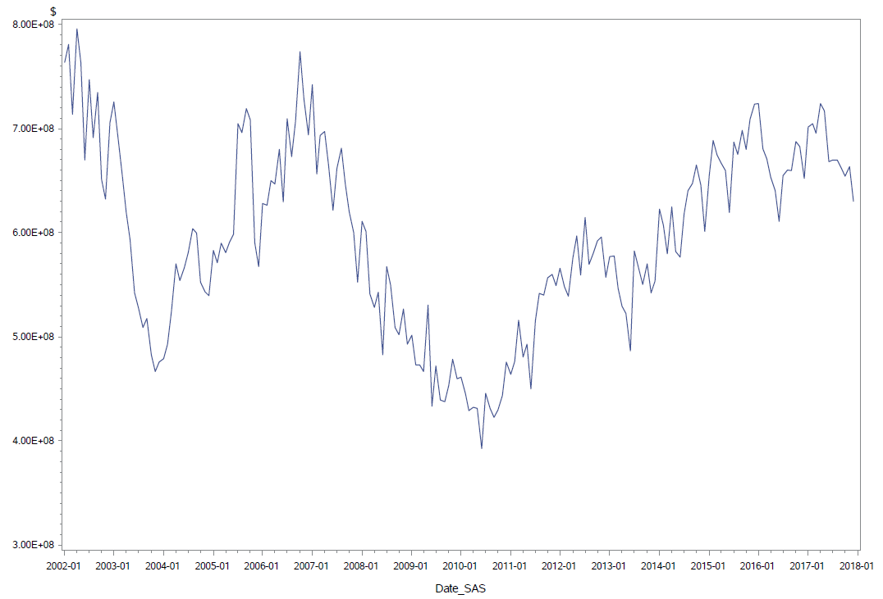
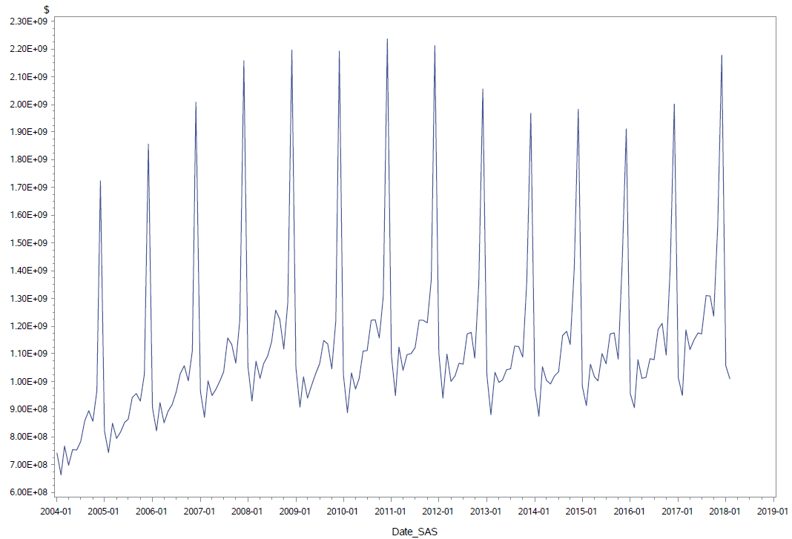
Empirical Comparison of Methods: Unadjusted
CASE 1: Low Seasonality, High Irregular
CASE 2: Low Seasonality, Low Irregular
CASE 3: High Seasonality, Low Irregular
Notes:
Selected a number of series to study, will present three that represent the range of typical series
Case I – difficult to adjust,
Case II – more typical. Case iii – easier to adjust,

Slide 2
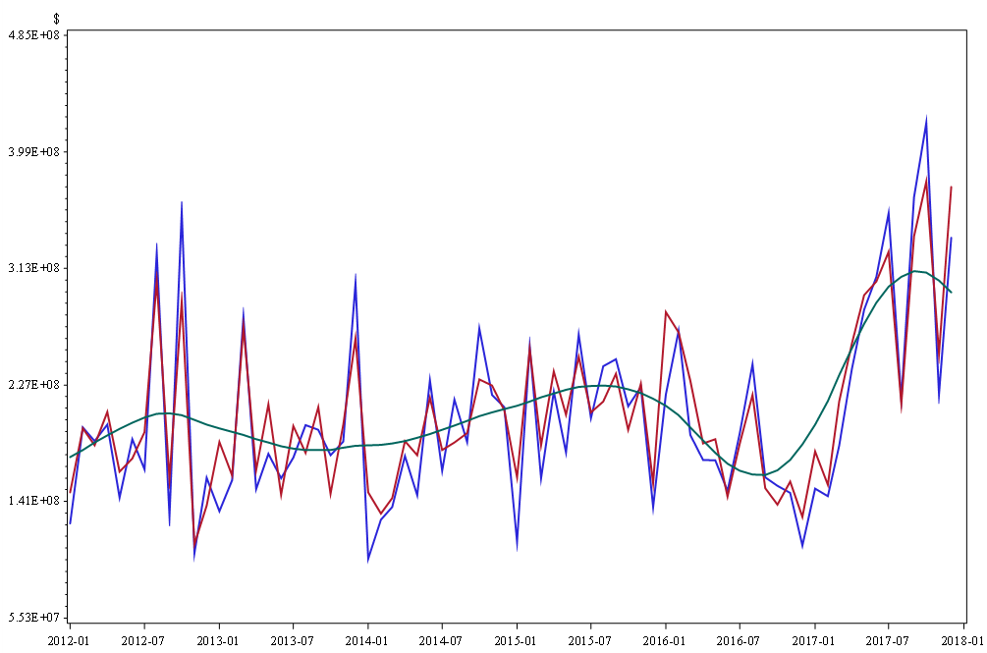
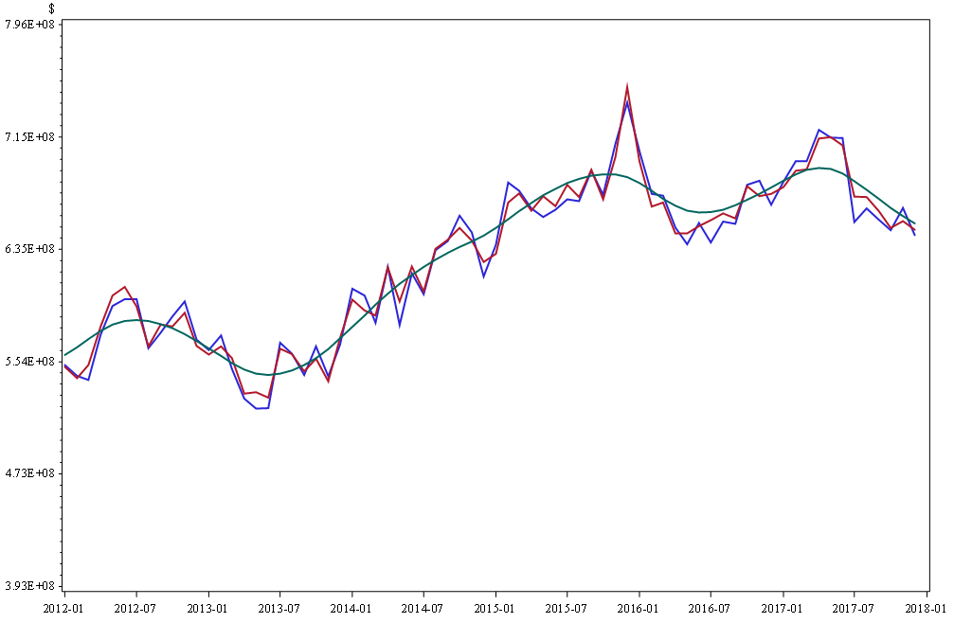
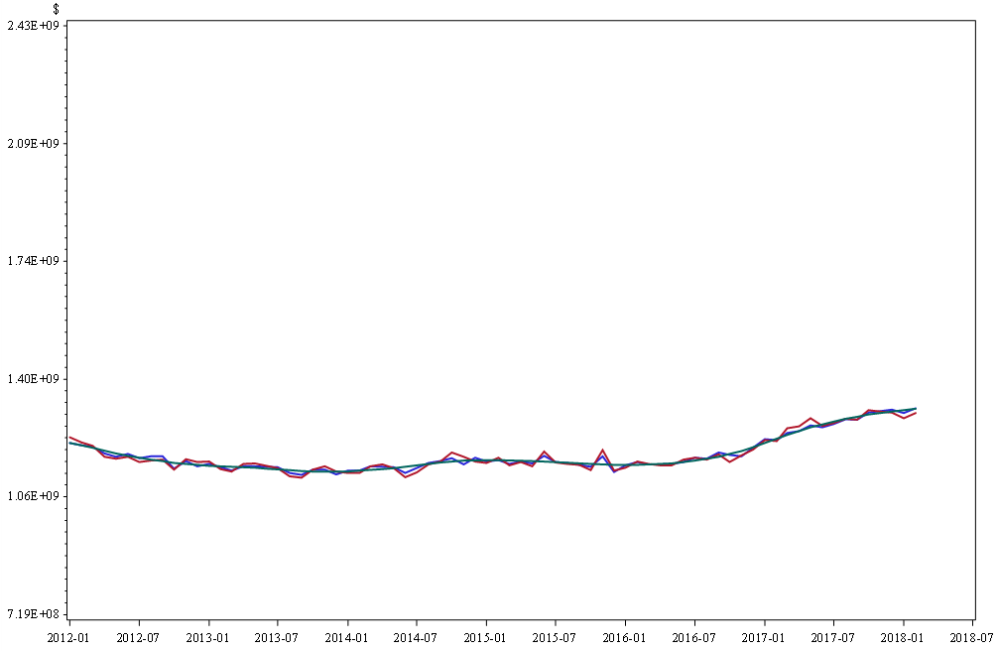
Empirical Comparison of Methods: Seasonally Adjusted
CASE 1: Low Seasonality, High Irregular
CASE 2: Low Seasonality, Low Irregular
CASE 3: High Seasonality, Low Irregular
X-12ARIMA
TRAMO-SEATS
Linear Trend, Trigonometric Seasonality
Notes:
Applied all three methods. Red, blue and green
SSM green is very smooth, has a small irregular. Looks more like what we typically see in trend-cycle series
X12-ARIMA and TRAMO-SEATS compare as expected.
Case I – difficult to model. Rough results but X12-ARIMA has fewer extreme movements
Case II – performance is very similar
Case III – model fits well, TRAMO-SEATS is smoother

